Slide 1
Azure Active Directory

Slide 2
AD synchronization
Configure Site to Site VPN
Configure Domain controller and DNS
Plan forest and domain relationship
Establish the site
While installing Domain controller
Make sure to store AD files on an attached disc and not on OS disk
DC should have one or two catalog service

Slide 3
Directory Synchronization
Sync Users/Groups and contacts from an on premises
Azure ad connect tool
Synch Filter/attribute based on the domain
Option for synch with or without pass

Slide 4
Pre req
On Premises DC-32 or 64 – bit 2003 SP1 or higher
Sync Computer - 64 bit Server 2008 R2 higher
Unsupported characters !#$%^&{}\{`~"/[]:<>+=;?*
User principle should not be blank
Idfix and admodify.net to fix the UPN(username)

Slide 5
Steps
Download AD-Connect
Configure AD-Connect Wizard
Configure AD recycle bin to restore accidently deleted users
Powershell can be used to synch the users

Slide 6
ADFS
Authentication happens to on premise servers unlike the Azure AD
Trust relationship between the on premise domain and the Microsoft online domain
Will redirect user to on premise server and generate the claim based authentication token from on premise server
Access granted to resource based on claims token
Ability to authenticate on prem applications and cloud based resources
Federated service using online service.

Slide 7
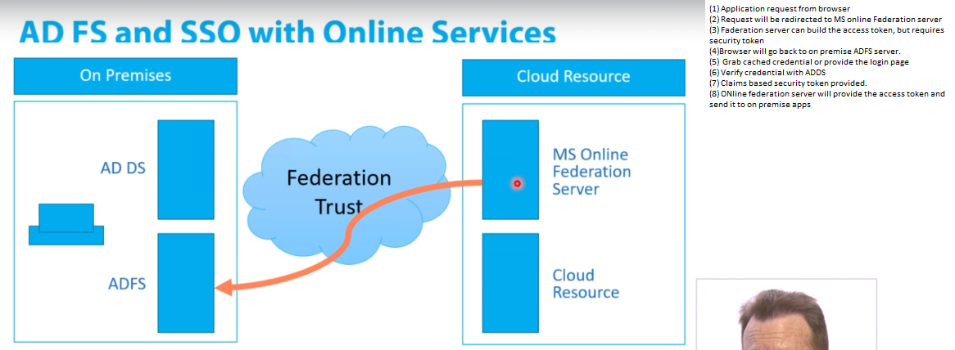
ADFS Flow

Slide 8
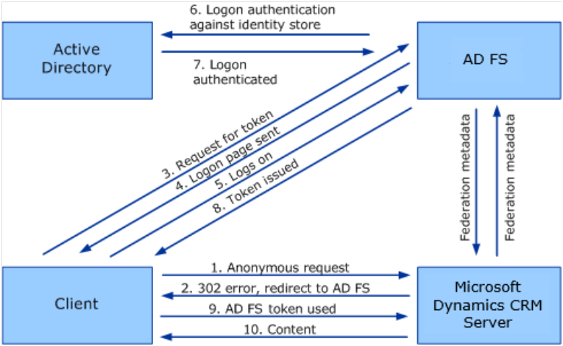
ADFS flow

Slide 9
Pre Requisites ADFS
Need Directory synchronization
Certificates
Database- Windows internal db, sql database

Slide 10
Steps
Install ADFS to on premise server

